Slide 1

Data Structures (資料結構)
Hung-Chang Hsiao (蕭宏章)
Professor
Distributed Computing Lab/CSIE/NCKU
分散式計算實驗室/成大資工
Slides from Textbook by Horowitz, Sahni, and Anderson-Freed

Slide 2

Introduction to Lecturer
Theory
  Distributed system
  Parallel/distributed algorithms
  Randomized algorithms (probability and computing)
Practices
  大型分散式系統軟體開發
  Apache Open Source Projcts developments
  產學合作

Slide 3

What the Course is About?
Data structures is concerned with the representation and manipulation of data.
All programs manipulate data.
So, all programs represent data in some way.
Data manipulation requires an algorithm.
Notes:
Data: Streets in a city. Mapquest.
Manipulation: Do something with the data. Add a new street. Close a street. Make a street one way. Find route from your home to nearest gas station. Input/output data.
Data representation: simple variables…int, float
array variables… int [], float []
Others to be studied in this course.
Algorithm…sequence of steps that results in the performance of a specific task (find nearest gas station to home).

Slide 4

What the Course is About?
  We shall study ways to represent data and algorithms to manipulate these representations.
  The study of data structures is fundamental to Computer Science & Engineering.
Notes:
What we do in this course will be used in most of the follow-up courses you will take. Essential to become expert in what we do this semester. Else, you will be handicapped in later courses. Foundation material.

Slide 5
Data Structures vs Algorithms
Data structures
  Ways organizing data items
  Methods manipulating the data items
Algorithms
  Repeated steps attacking a problem
  A problem may be defined as an efficiency design of some “data structure”
This course emphasizes on “data structures” and some of their applications, e.g.,
  Stacks (data structure) and rat in a maze (applications)
Some overlaps between data structures and algorithms
  Performance analysis on “methods” manipulating a data structure
  本課程優先講授 “資料結構”，有餘力才會分配時間講授 “演算法” (e.g., max flow problem)

Slide 6
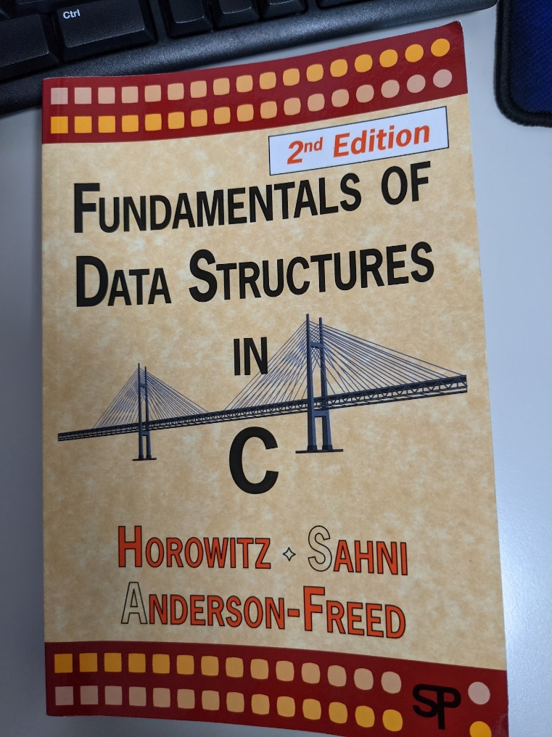
Textbook
主要題材來自於這本書
可能有少許但常見、經典、有趣的題材會超出課本範圍
  Google
  教科書先前的版本

Slide 7
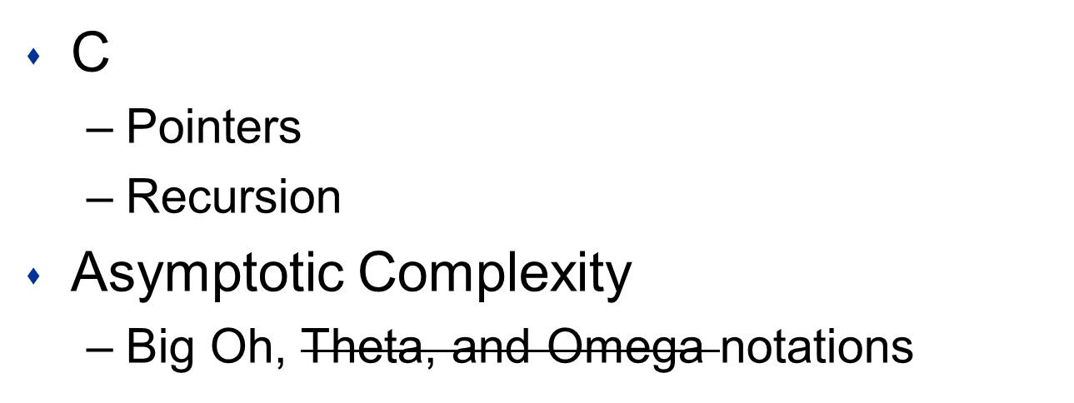
Prerequisites

Slide 8

Web Site
Moodle: 所有的訊息公佈以Moodle為主

Slide 9




Assignments
Assignment guidelines
Submission procedures
Notes:
Must follow guidelines and submission procedures. Else there will be chaos.

Slide 10
Grades (Plan A)
計分精神:
每個資料結構有兩次學習的要求
作業
考試
x% for assignments (+/-10%)
y% for tests (+/-10%)
x+y=100%
x=45 (expected 4 programming assignments)
y=55 (midterm 25 + final 30)

Slide 11
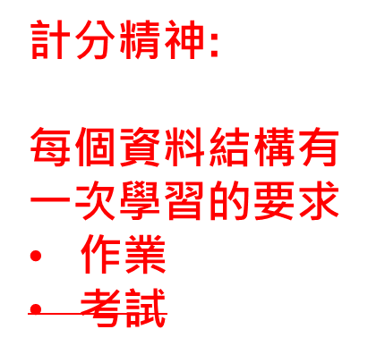
Grades (Plan B 沒有實體考試)
x% for assignments (+/-10%)
y% for tests (+/-10%)
x+y=100%
x=100 (expected 4 programming assignments)
y=0 (midterm 0 + final 0)

Slide 12
TA and Office Hours
To be announced in Moodle

Slide 13
Objectives of the Course
Learn some fundamental, but practical data structures
Objective:
  在上述基礎下，修完這門課的學生被期許有能力能自己學習沒有教授的內容，使應用將來可能的就業/進修需求
The course is NOT to help particiapants go through every “words” in the textbook

Slide 14
Sorting
Problem: Give a sorted list storing a set of (distinct) numbers in ascending (or descending) ordering //提供一種資料結構，其中儲存的數字按遞增或遞減的次序排列
  輸出一排序的陣列arrary (使用者能輸入一組數字)
  Rearrange a[0], a[1], …, a[n-1] into ascending order. When done, a[0] <= a[1] <= … <= a[n-1]
  8, 6, 9, 4, 3 => 3, 4, 6, 8, 9
Notes:
Strictly speaking, nondecreasing order: 2, 2, 3, 6, 8, 8, 10.

Slide 15
該資料結構的內部操作:
Sort Methods
Insertion Sort
Bubble Sort
Selection Sort
Count Sort
Shaker Sort
Shell Sort
Heap Sort
Merge Sort
Quick Sort
Notes:
First 5 are simple (conceptually and to program). First 4 done in chapters 2 and 3. Shaker sort and shell sort are in the enrichment section of the text’s Web site. The remaining three are done in the algorithm design chapters of the text.

Slide 16
Insert an Element
Given a sorted list/sequence, insert a new element
Given 3, 6, 9, 14
Insert 5
Result 3, 5, 6, 9, 14

Slide 17
Insert an Element
3, 6, 9, 14 insert 5
Compare new element (5) and last one (14)
Shift 14 right to get 3, 6, 9, , 14
Shift 9 right to get 3, 6, , 9, 14
Shift 6 right to get 3, , 6, 9, 14
Insert 5 to get 3, 5, 6, 9, 14
計算機比人類適合進行反覆相同的動作

Slide 18
Insert an Element
/* insert t into a[0:i-1] */
int j;
for (j = i - 1; j >= 0 && t < a[j]; j--)
a[j + 1] = a[j];
a[j + 1] = t;
Notes:
Note that this code is different from that given in Chapter 7. First, we sort a[0:n-1] here whereas we sort a[1:n] in Chapter 7. Also, we use a for loop here whereas we use a while loop in Chapter 7.

Slide 19
Insertion Sort
Start with a sequence of size 1
Repeatedly insert remaining elements
Divide and Conquer

Slide 20
Insertion Sort
Sort 7, 3, 5, 6, 1
Start with 7 and insert 3 => 3, 7
Insert 5 => 3, 5, 7
Insert 6 => 3, 5, 6, 7
Insert 1 => 1, 3, 5, 6, 7

Slide 21
Insertion Sort
for (i = 1; i < n; i++)
{/* insert a[i] into a[0:i-1] */
/* code to insert comes here */
}

Slide 22
Insertion Sort
for (i = 1; i < n; i++)
{/* insert a[i] into a[0:i-1] */
int t = a[i];
int j;
for (j = i - 1; j >= 0 && t < a[j]; j--)
a[j + 1] = a[j];
a[j + 1] = t;
}

Slide 23
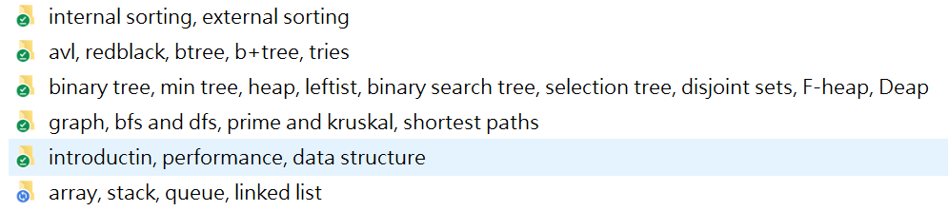
What Data Structures are Covered in this Course?
期中考以前 (預期)
共約1000 slides，平均每次上課要講至少60張slides

Slide 24
功課會很多，尤其是程式練習
建議現在就開始寫程式，每個程式不大 (可能最多幾百行程式碼)，但這樣的程式數量會很不少
比方，期中考前每位同學可能要完成高達20個資料結構的程式作業 (分兩梯次繳交，每一梯次約10個)
不好高騖遠，至少我們講過的資料結構，修課同學都有確實動手寫程式練習過
越是後面講述的資料結構越是基於前面的基礎，因此宜保留前面的作業供後續資料結構使用 (或每次都重寫也很好)
有沒有問題?

